Slide 1
Submariner

Slide 2
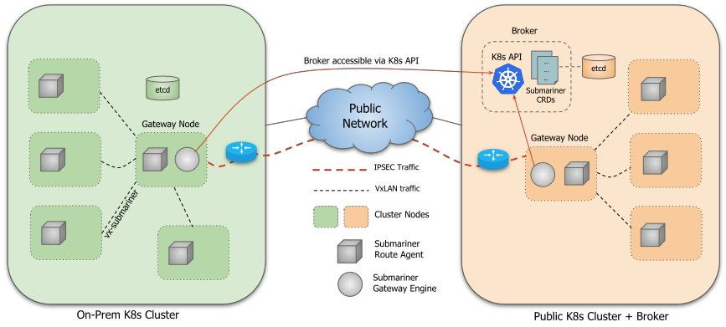
What is Submariner?
Submariner connects multiple Kubernetes clusters in a way that is secure and performant.
It flattens the networks between the connected clusters, and enables IP reachability between Pods and Services
It also provides, via Lighthouse, service discovery capabilities.
Exposes a set of new Custom resources (CRDs) backed by kubernetes datastore ( ClusterSet, Endpoint, ServiceExport/Import )
Can be deployed using Operator, Helm and subctl.

Slide 3
Components of Submariner
Submariner consists of several main components that work in conjunction to securely connect workloads across multiple Kubernetes clusters, both on-premises and on public clouds:
Gateway Engine: manages the secure tunnels to other clusters.
Route Agent: routes cross-cluster traffic from nodes to the active Gateway Engine.
Broker: facilitates the exchange of metadata between Gateway Engines enabling them to discover one another.
Service Discovery: provides DNS discovery of Services across clusters.
Submariner has optional components that provide additional functionality:
Globalnet Controller: handles interconnection of clusters with overlapping CIDRs.

Slide 4
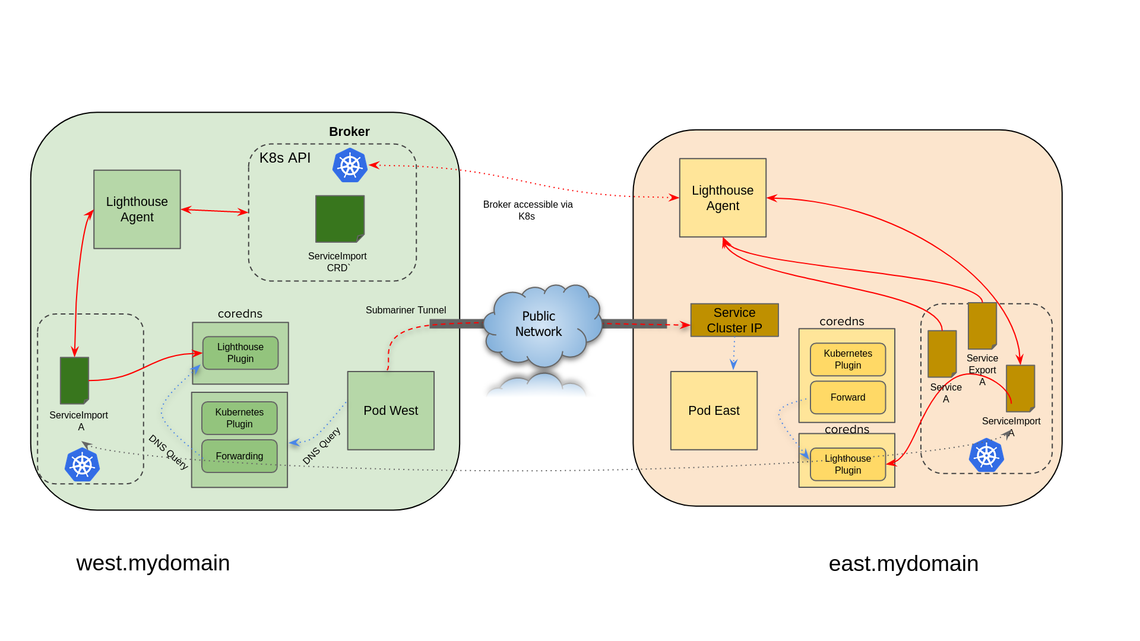
Service Discovery
The Lighthouse project provides DNS discovery for Kubernetes clusters connected by Submariner in multi-cluster environments.
Lighthouse is an implementation of the Kubernetes Multi-Cluster Service APIs.
The Lighthouse Agent runs in every cluster and accesses the Kubernetes API server running in the Broker cluster to exchange service metadata information with other clusters. Local Service information is exported to the Broker and Service information from other clusters is imported.

Slide 5
Admiralty

Slide 6
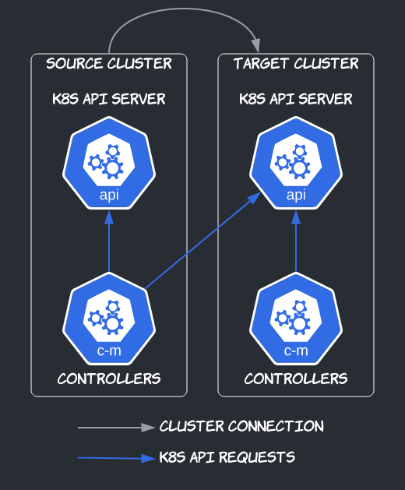
Admiralty
Admiralty connects the control planes of Kubernetes clusters.
Two clusters are said to be connected as source and target when controllers in the source cluster (e.g., run by the Admiralty agent) talk to the Kubernetes API of the target cluster.

Slide 7
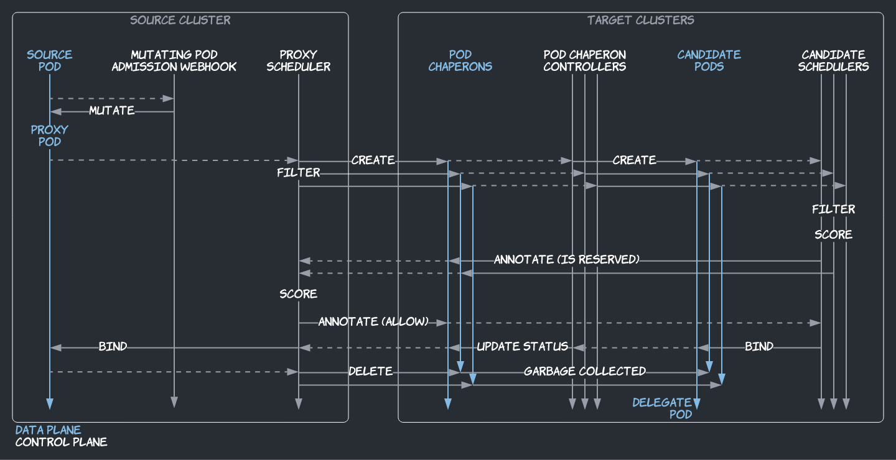
Multi-cluster Scheduling Architecture
Multi-cluster scheduling is supported by four components run by pods in Admiralty's installation namespace (typically, admiralty):
a mutating pod admission webhook,
the proxy scheduler,
the pod chaperon controller, and
the candidate scheduler.
For a given source pod, the mutating pod admission webhook and proxy scheduler are acting in the cluster where the source pod is created, whereas the pod chaperon controller and candidate scheduler are acting in target clusters of that source cluster.

Slide 8
Takeaways
Lighthouse agent: It connect the Kubenetes Api’s Server of other cluster and does the seriveExport and serviceImport of the services to the other cluster.
Multi-Cluster scheduling of Admiralty.

Slide 9
Liqo

Slide 10
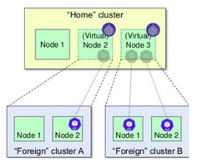
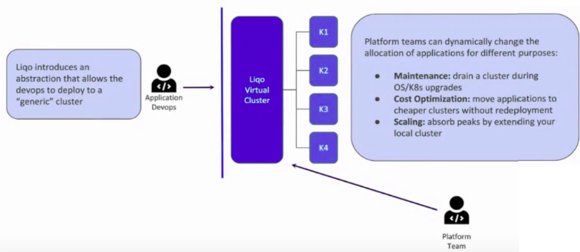
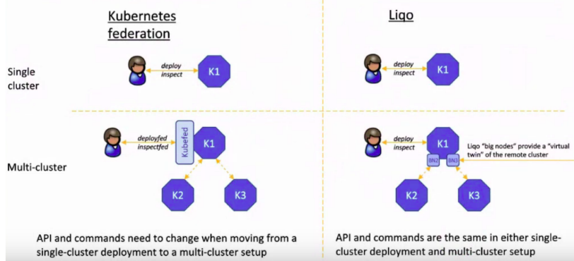
Liqo
Liqo, an open-source project that creates a virtual cluster that spans multiple real clusters, either on-prem or managed (AKS, EKS,GKE), and instantiates the desired applications seamlessly in the appropriate cluster.
Liqo aims to create an opportunistic interconnection of multiple Kubernetes clusters allowing seamless resource and service sharing among them, creating an "endless Kubernetes ocean" where the user applications can be scheduled.

Slide 11
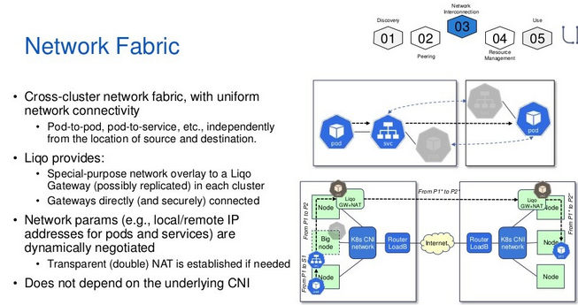
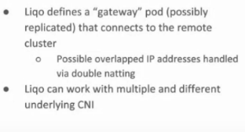

Slide 12
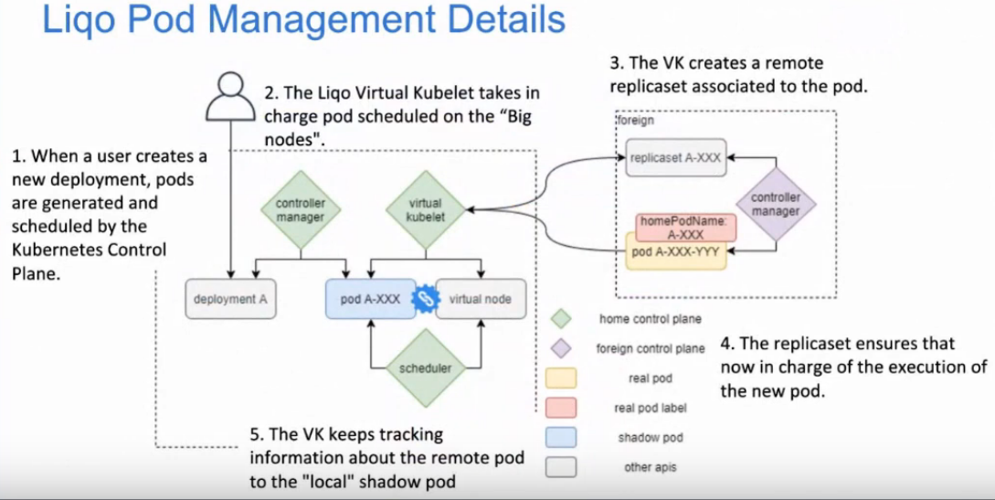

Slide 13
Takeaways
Liqo is about multi cluster abstraction and resource sharing across multiple clusters.
Egdegallery don't have any requirement related to clusters interconnection or sharing resources deployed in other cluster. If need arises Liqo can be leveraged in edgegallery

Slide 14

Crossplane

Slide 15

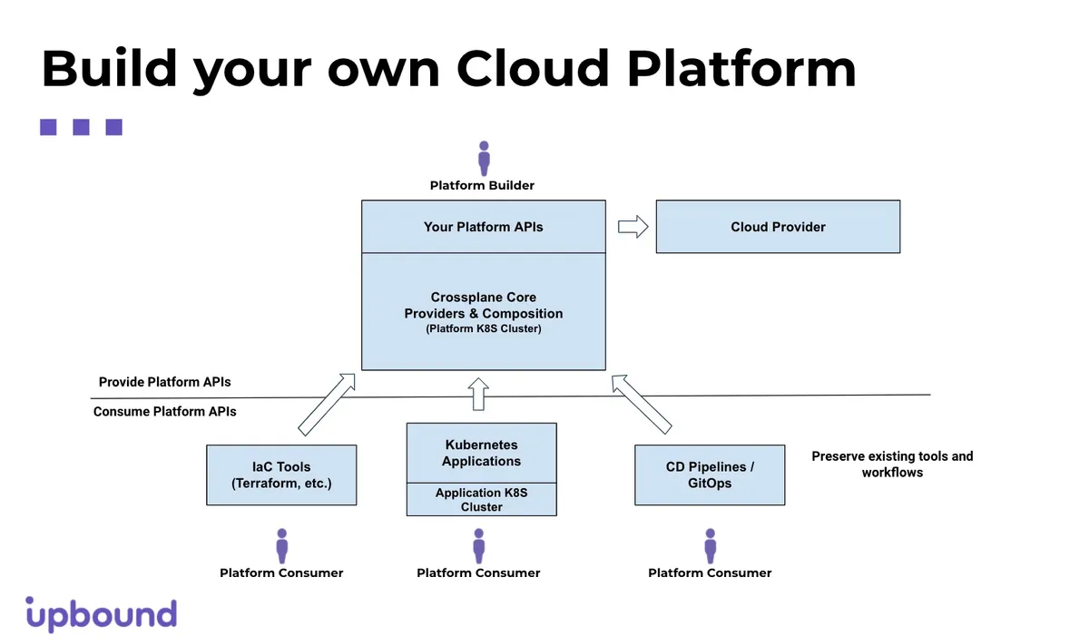
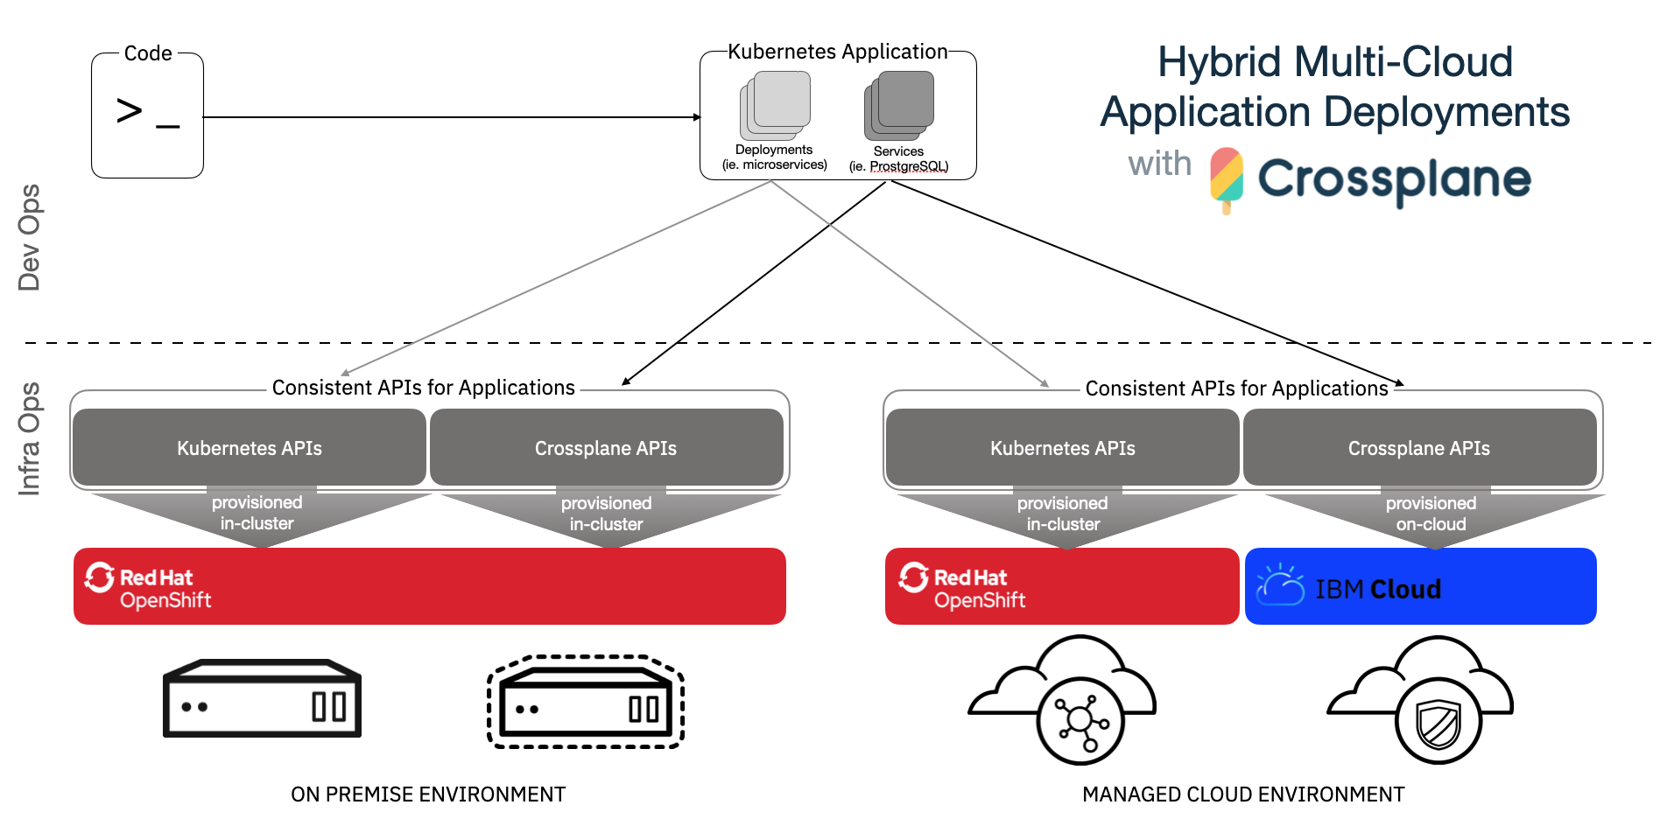
Crossplane
Crossplane is implemented as a Kubernetes add-on and extends any cluster with the ability to provision and manage cloud infrastructure, services, and applications.
Crossplane uses Kubernetes-styled declarative and API-driven configuration and management to control any piece of infrastructure, on-premises or in the cloud. Through this approach, infrastructure can be configured using custom resource definitions (CRDs) and YAML.
It can also be managed via well established tools like kubectl or via the Kubernetes API itself. The use of Kubernetes also allows the definition of security controls, via RBAC, or policies, using Open Policy Agent (OPA) implemented via Gatekeeper.
As part of the Crossplane installation a Kubernetes resource controller is configured to be responsible for the entire lifecycle of a resource: provisioning, health checking, scaling, failover, and actively responding to external changes that deviate from the desired configuration.
Crossplane integrates with continuous delivery (CD) pipelines so that application infrastructure configuration is stored in a single control cluster. Teams can create, track, and approve changes using cloud native CD best practices such as GitOps.

Slide 16
Crossplane
A CNCF Kubernetes orchestration project that was promoted from sandbox to incubation.
Crossplane and Upbound.io were created by Tabbara in late 2018. Crossplane was accepted by the Cloud Native Computing Foundation (CNCF) as a sandbox project in May 2020 and promoted to the intermediate incubation stage sept-2021.
To reach incubation, Crossplane had to demonstrate production use, among other criteria. It cited users including Accenture, Deutsche Bahn, Plotly, Ripcord and Zego.
Crossplane extends the Kubernetes control plane, originally created to manage container workloads, to manage resources such as virtual machines and cloud storage objects as well.
This is typically the territory of infrastructure-as-code tools such as HashiCorp's Terraform and AWS CloudFormation, which are widely used to automate the provisioning of infrastructure that underpins Kubernetes clusters.
"Using a Kubernetes control plane and declarative API to manage infrastructure, and a set of controllers to reconcile and automate the lifecycle of these resources.. is a step up from infrastructure as code".
Crossplane takes the concept of Infrastructure as Code (IaC) to the next level through its tight integration with Kubernetes.
Crossplane can also orchestrate higher-level application components such as databases and message queues -- virtually anything that can be accessed via an API.
Two of the big three public cloud vendors, AWS and Azure, have certified Crossplane providers for their cloud infrastructure and services, including identity and access management accounts. A Google Cloud Platform certification is in the works.
Next, the project must continue to grow its user base and community of contributors to reach the CNCF graduation stage. Companies other than Upbound -- which include Alibaba, Red Hat and IBM -- account for half of the contributions to the project, but it will take more work to ensure the project's governance is split among more companies,

Slide 17









Crossplane
Provider Certified
Contributors
Official Users
AI & ML based data analytics and deep machine learning
Software services
Deutsche Bahn
German Railways
Online data analytics and visualization tools

Slide 18
Crossplane
While Red Hat is contributing to Crossplane, company officials declined to comment on whether there are any plans to integrate it with the OpenShift Kubernetes platform.
Crossplane's Compositions mechanism could mean the platform team can let developers provision resources such as MySQL databases or S3 buckets alongside their applications without making them deal with nitty-gritty parameters such as instance type and memory size.
Consultants from Accenture also used Crossplane as part of the foundation for a DevOps platform they built for German railway utility Deutsche last year.
Crossplane presents a declarative management style API that covers a wide range of abstractions including databases, message queues, buckets, data pipelines, serverless, clusters, and many more.
Crossplane is responsible for maintaining records for all objects managed by it, and runs controllers that automate the management of workloads across cloud providers. Controllers use the declarative configuration and are able to make changes, react to failures, and optimize services without involving an admin.
Workloads consume resources which can be based on existing managed services of a cloud provider or independent cloud offerings. Resources can be statically or dynamically provisioned, and are automatically bound to the workloads that are consuming them. Crossplane along with specialized resource controllers automate the binding of resources to workloads, passing connection information, and dealing with network and security access.

Slide 19
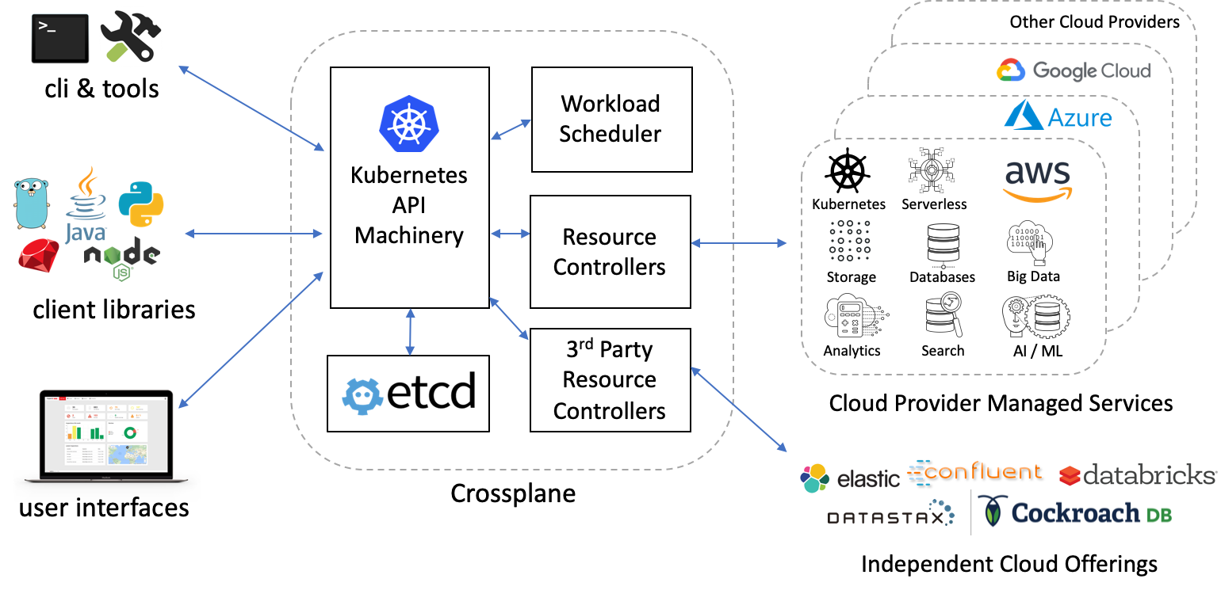
Crossplane Arch
Crossplane includes a workload scheduler that can factor a number of criteria including capabilities, availability, reliability, cost, regions, and performance while deploying workloads and their resources.
The scheduler works alongside specialized resource controllers to ensure policies set by administrators are honored.
Crossplane supports a clean separation of concerns between developers and administrators.
Developers define workloads without having to worry about environment constraints, and policies.
Administrators can define environment specifics, and policies. The separation of concern leads to a higher degree of reusability and reduces complexity.
Finally, Crossplane is designed for extensibility at every level. Adding new APIs, resource controllers, schedulers, and other components can be done easily and without requiring code in-tree. A big goal of Crossplane is to be a platform for multicloud development and to empower the open source community to build on-top of it.
Crossplane is based on the declarative resource management architecture of the popular Kubernetes project. Crossplane uses the unmodified Kubernetes API server (kube-apiserver), etcd, and a few of the core controllers.
Crossplane can run directly on-top of an existing Kubernetes cluster without requiring any changes.
Kubernetes is a container orchestrator and is responsible for managing containers (pods), and the resources they consume (storage volumes, and networking) across a set of nodes.
Crossplane is a multicloud workload and resource orchestrator and manages workloads (container, serverless, others) and resources they consume (databases, message queues, buckets, data pipelines, and others) across a set of cloud providers or on-premise environments. Crossplane can be thought of as a higher-order orchestrator across cloud providers.

Slide 20
Crossplane Goals
Crossplane has great support for container workloads, it does not mandate their use. You can use Crossplane for scenarios and workloads that do not involve containers at all.
Goals
Crossplane has the following goals:
Enable a higher degree of workload portability via abstractions.
Define a clean separation of concern between administrators and developers.
Use existing managed services of a cloud provider.
Use new cloud offerings from independent companies, like CockroachDB, Mongo, Confluent, Elastic and others that are not necessarily tied to a cloud provider.
Support static and dynamic provisioning of resources.
Give administrators full control of their clouds using policy, limits and quotas.
Enable full lifecycle management of resources via controllers.
Expose rich extensibility points enabling others to easily build on-top of Crossplane.
Full extensibility even for out-of-tree code.
Leverage as much of the Kubernetes declarative management machinery as possible.
Leverage as much of the cloud-native ecosystem as possible.
The following are non-goals:
Directly orchestrate container workloads on nodes.
Replace managed services in cloud providers.
Replace operators and controllers written for platform services.
Favor running platform software on Kubernetes in containers.
Improve the developer experience around YAML and configuration.
Improve the workflow of building, packaging, and deploying applications.
Define a packaging format for workloads or applications.

Slide 21
Why use Crossplane to manage both applications and infrastructure?
Declarative infrastructure configuration - Crossplane brings Kubernetes-styled declarative and API-driven configuration and management to any piece of infrastructure, on-premises and in the cloud. Through this approach, infrastructure managed through Crossplane is accessible via kubectl, configurable with YAML, and self-healing right out of the box.
Unify application and infrastructure configuration and deployment - Crossplane enables application and infrastructure configuration to co-exist on the same Kubernetes cluster, reducing the complexity of your toolchains and deployment pipelines.
One source of truth for infrastructure configuration and setup - Crossplane integrates with CI/CD pipelines so application infrastructure configuration is stored in a single control cluster. Teams can create, track, and approve changes using GitOps best practices already in use.
Automate operational tasks with reconciling controllers - A resource controller is responsible for the entire lifecycle of a resource. This resource is responsible for provisioning, health, scaling, failover, and actively responding to external changes that deviate from the desired configuration.
Built with high levels of extensibility - Crossplane leverages broadly accepted Kubernetes patterns, making it easily extensible by adding your own APIs and controllers. Increase flexibility and security by baking policies, quotas, and permissions into a custom infrastructure definition.
A strong separation of concerns - Developers can define workloads without worrying about implementation details, environment constraints, or policies. Administrators can define environment specifics and policies. Enable a higher degree of reusability and reduce complexity.

Slide 22
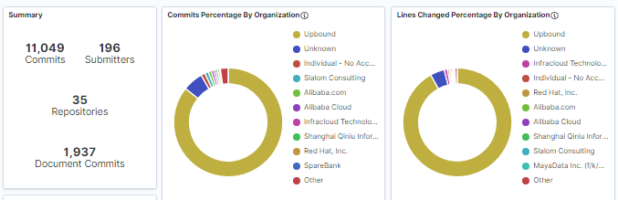
Community Insights
https://www.cncf.io/projects/crossplane/
https://github.com/crossplane/crossplane
https://insights.lfx.linuxfoundation.org/projects/cncf%2Fcrossplane

Slide 23
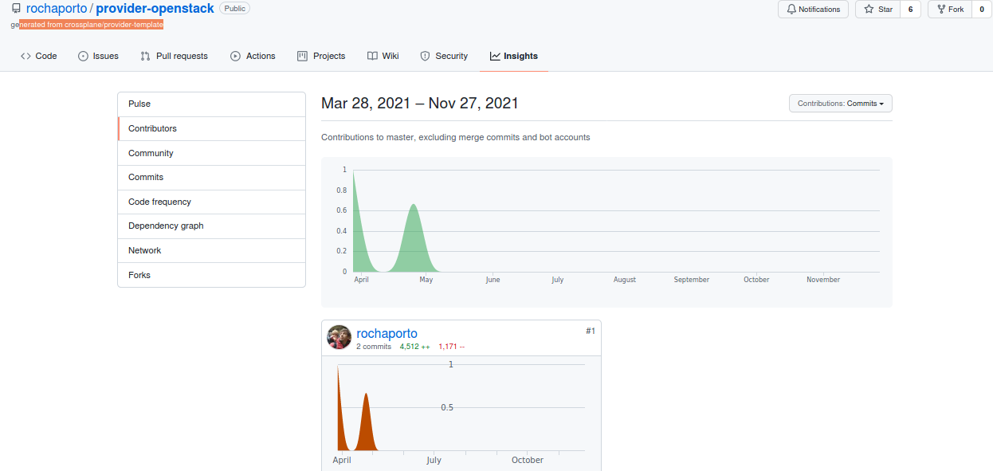
rochaporto/provider-openstack:
This project is very rudimentary, looking at the code, almost nothing is done.
rochaproto/Provider-openstack: The provider for openstack operations available in github but its only basic framework implemented using provider-template from crossplane and not mature enough to use it even for basic openstack operations operations.
Note: Implementation of openstack provider using provider-template from crossplane, effort will be huge to support openstack operations.

Slide 24
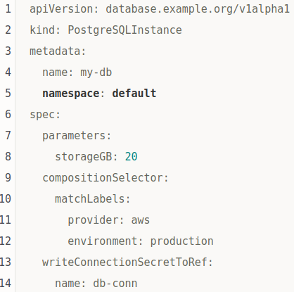
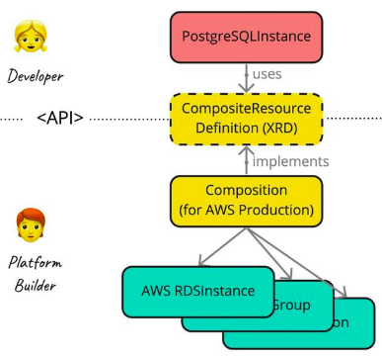
Crossplane Advantages
1. A Developer-Friendly API
2. Powerful and Flexible With Compositions.
3. Production-Ready With the Help of K8s.
It uses Kubernetes controllers and the concept of continuous
reconciliation to run the platform. If something breaks
(which it will), Crossplane will examine and fix the state.
4. Open Source & Open Governance.
Crossplane is not only
Open Source (Apache 2.0), but
as part of the CNCF, it’s also openly
governed.

Slide 25
MECM
Crossplane
Crossplane is based on k8s operator framework.
Vendors can implement providers to manage their resources.
Perform complete life cycle management of infrastructure, workloads and services.
Dependent cloud services (like RDS service in AWS) dynamically provisioned based on the workload (wordpress) and its binding with cloud services..
Developers can define workloads without worrying about implementation details, environment constraints, or policies. Administrators can define environment specifics and policies. Enable a higher degree of reusability and reduce complexity.
Kubernetes-styled declarative and API-driven configuration and management to any piece of infrastructure.
Support cluster scaling vertical and horizontal using autoscalar.
Support K8s based workloads but can be extended to non K8s based workloads with provider support.
1. MECM performs application orchestration and manages lifecycle of the application.
2. It's not based on K8s operator framework.
3. Do not support custom resources.
4. MECM support deployment of K8S and also VM based applications
5. Supports VM provisioning using openstack.
6.MECM has mechanism of plugins(plug & play) instead of resource controller where in 3rd party can bring in there own plugins to deploy workloads.
7.Monitoring is not supported.
8. Does not support cluster scaling vertical and horizontal.

Slide 26
Take Away
Crossplane is an open source cloud control plane that enables engineers to provision infrastructure from the Kubernetes API. It can be used by organisations to build and operate an internal platform-as-a-service (PaaS) across a variety of infrastructures and cloud vendors. Crossplane has recently been accepted into the CNCF as a sandbox project.
Infrastructure and applications can be packaged together in a bundle using Crossplane. Kubernetes Custom Resources can be used to declaratively specify this configuration, and a Crossplane uses the control loop model to continually reconcile the specified config with what is running in the target environment.
OAM describes a model where developers are responsible for defining application components, while application operators are responsible for creating instances of those components and assigning them application configurations. Infrastructure operators are responsible for declaring, installing, and maintaining the underlying services that are available on the platform.
The recently released Upbound Registry will contain a collection of existing cloud providers (Alibaba, AWS, Azure, GCP, etc), stacks (curated environment configurations), and bundles of existing applications and infrastructure.

Slide 27
Take Away
Crossplane can be used to manage workloads spanning multiple Kubernetes clusters.
Communication between these clusters is outside of Crossplane’s purvey, and instead API gateway technologies like the Ambassador Edge Stack, and service mesh technologies, such as Linkerd, will provide this functionality.

Slide 28
Take Away
Crossplane is an excellent tool for IAC, but lacks a stable Open stack provider at the moment.
The effort for the MECM to adopt Crossplane would need the OS-Plugin needs to be re-written in order to support the operations
The current owner for the OS-plugin in 21st century.
We need to implement this module in order to have the E2E (support both VM and CNF) functionality implemented, this needs further analysis based on the crossplane provider and OS–Plugin understanding.

Slide 29
Conclusion
After analyzing multiple orchestrators such as Armada, Airship, HPE edge orchestrator, EMCO, Ericsson dynamic orchestrator(EDO), Open Horizon, Baytel, liqo etc…
Crossplane stands out,
It provides a set of Kubernetes Operators to help infrastructure teams and developers adopt a hybrid-cloud strategy.
Crossplane allows users to provision infrastructure from most major cloud providers (AWS, GCP, Azure), with support frequently being added for new resources and providers.The infrastructure resources created by Crossplane can be accessed, edited, and deleted just like any other resource in Kubernetes.
By providing custom Kubernetes resources and an extensible interface, Crossplane allows users to switch between cloud providers to avoid vendor lock-in.
Edgegallery can leverage Crossplane for container orchestration as well as for Infra management, VM based workload can also be supported with openstack crossplane provider implementation.

Slide 30
References:
https://www.infoq.com/articles/crossplane-paas-kubernetes/
https://www.forbes.com/sites/janakirammsv/2021/09/15/how-crossplane-transforms-kubernetes-into-a-universal-control-plane/?sh=27740f556386
https://blog.csdn.net/xialingming/article/details/120484509
https://docs.google.com/document/d/1whncqdUeU2cATGEJhHvzXWC9xdK29Er45NJeoemxebo/edit#
https://blog.csdn.net/xialingming/article/details/120304088?ops_request_misc=%257B%2522request%255Fid%2522%253A%2522163795865316780271951506%2522%252C%2522scm%2522%253A%252220140713.130102334.pc%255Fall.%2522%257D&request_id=163795865316780271951506&biz_id=0&utm_medium=distribute.pc_search_result.none-task-blog-2~all~first_rank_ecpm_v1~rank_v31_ecpm-1-120304088.first_rank_v2_pc_rank_v29&utm_term=%E6%95%B0%E6%8D%AE%E5%BA%93crossplane&spm=1018.2226.3001.4187
https://searchitoperations.techtarget.com/news/252508176/Crossplane-project-could-disrupt-infrastructure-as-code

Slide 31
Thanks

Slide 32
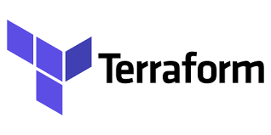
Terraform is a popular tool for provisioning infrastructure across cloud providers. It offers a declarative configuration language with support for templating, composability, referential integrity and dependency management.
Terraform can dynamically provision infrastructure and perform changes when the tool is run by a human. Unlike Crossplane, Terraform does not support workload portability across cloud providers, and does not have any active controllers that can react to failures, or make changes to running infrastructure without human intervention. Terraform attempts to solve multicloud at the tool level, while Crossplane is at the API and control plane level. Terraform is open source under a MPL license, and follows an open core business model, with a number of its features closed source. We are evaluating whether we can use Terraform to accelerate the development of resource controllers in Crossplane.

Slide 33

Pulumi is a product that is based on terraform and uses most of its providers.
Instead of using a configuration language, Pulumi uses popular programming languages like Typescript to capture the configuration.
At runtime, Pulumi generates a database availability group (DAG) of resources just like terraform and applies it to cloud providers.
Pulumi has an early model for workload portability that is implemented using language abstractions.
Unlike Crossplane, it does not have any active controllers that can react to failures, or make changes to running infrastructure without human intervention, nor does it support workload scheduling.
Pulumi attempts to solve multicloud scenarios at the language level, while Crossplane is at the API and control plane level. Pulumi is open source under a APL2 license but a number of features require using their SaaS offering.

Slide 34
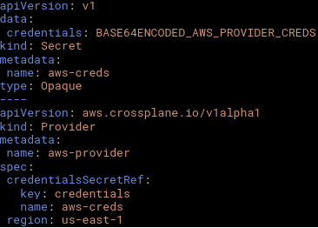
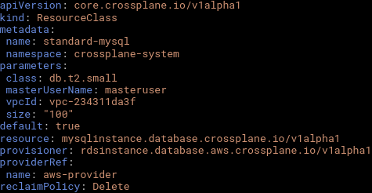
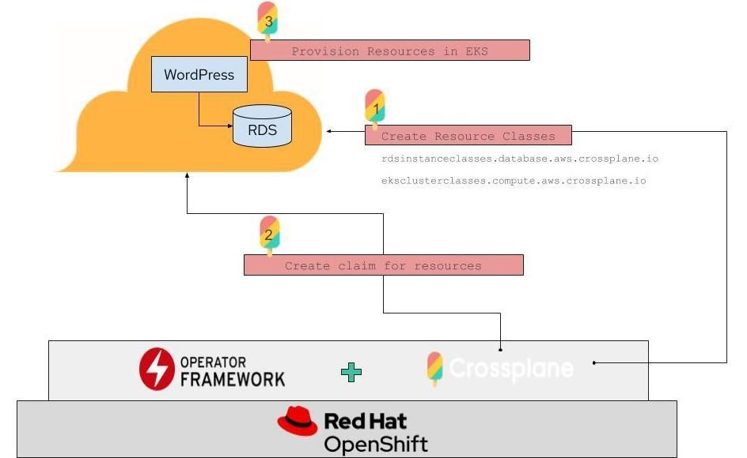
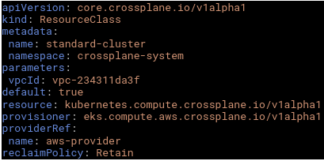
Crossplane Walk-through - Admin perspective
Crossplane can be installed using a helm chart: helm install --name crossplane crossplane
Using AWS for this example, even through the same example can run on GCP and Azure too. Let’s add credentials for AWS in a Secret object. We will also create a Provider that has a reference to the secret and specifies the AWS region we’d like to use.
Next we will create a ResourceClass that acts as a template with implementation details and policy for resources that will be dynamically provisioned by the workload. Since the Wordpress example requires a MySQL database instance, we’ll create a ResourceClass that supports dynamically provisioning a database instance using Amazon RDS service:
The standard-mysql resource class specifies that the RDS provisioner is to be used when a developer requests an instance of MySQLInstance.The class also specifies a set of parameters that are specific to the provisioner, implementation or environment. In the future a resource class will also include policy that can constrain the kinds of resources created.
The standard-cluster resource class specifies a Kubernetes cluster that uses the EKS provisioner, and configures an AWS VPC for it.
Next we will create another ResourceClass,
this time for a Kubernetes cluster

Slide 35
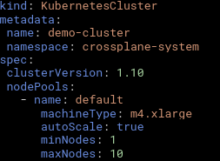
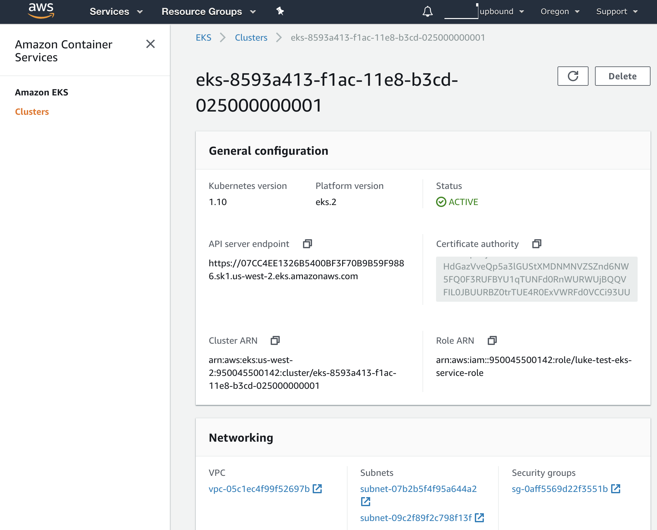
Crossplane Walk-through
Now let’s create an instance of a Kubernetes cluster for use by container workloads:
Using the information in the standard-cluster resource class and the demo-cluster resource claim, a new EKS cluster is dynamically provisioned and includes the configuration from both.
The EKS cluster will be setup with a default node pool that includes the minimum number of worker nodes. We can inspect the EKS object as follows:
The EKS cluster that is provisioned:
We created a single cluster to host workloads, and in the future even the cluster will be dynamically provisioned using an autoscaler.

Slide 36
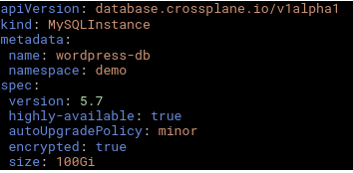
Crossplane Walk-through - Developer perspective
With Crossplane, a developer writes portable configuration, and is generally not concerned about the cloud provider, credentials, and other details of the environment. Let's start by creating the configuration for a MySQL database instance that is needed by wordpress. This configuration acts as a request for a MySQL database server instance, we refer to it as a resource claim.
The spec defines the requirements for the MySQL instance independent of any implementation.
The rest of the implementation or environment specific details come from the default resource class as defined by the administrator.

Slide 37
Crossplane Walk-through
apiVersion: container.crossplane.io/v1alpha1
kind: Workload
metadata:
name: wordpress
namespace: demo
spec:
# the version of Kubernetes desired
clusterVersion: 1.10
# the namespace to create on a target cluster
targetNamespace: wordpress
# this is a template for a deployment to be created on a target cluster
targetDeployment:
Next let's create a workload configuration that defines a container workload to run wordpress.
A workload is a schedulable unit of work and contains a payload and requirements for where and how the workload should run.
A workload scheduler is responsible for deploying the workload and in this case it will be scheduled to run on the EKS Kubernetes cluster provisioned by the administrator.
- name: WORDPRESS_DB_USER
valueFrom:
secretKeyRef:
name: wordpress-db-connection
key: username
- name: WORDPRESS_DB_PASSWORD
valueFrom:
secretKeyRef:
name: wordpress-db-connection
key: password
ports:
- containerPort: 80
name: wordpress
metadata:
name: wordpress
labels:
app: wordpress
strategy:
type: Recreate
template:
metadata:
labels:
app: wordpress
spec:
containers:
- name: wordpress
image: wordpress:4.6.1-apache
env:
- name: WORDPRESS_DB_HOST
valueFrom:
secretKeyRef:
name: wordpress-db-connection
key: endpoint
- name: WORDPRESS_DB_USER
valueFrom:
secretKeyRef:
name: wordpress-db-connection
key: username
-
# this is a template for a service to be created on a target cluster
targetService:
metadata:
name: wordpress
spec:
ports:
- port: 80
selector:
app: wordpress
type: LoadBalancer
# these are the resource used by this workload. The secret holding the connection
# information will be generated and propagated to the target cluster.
resources:
- name: wordpress-db
kind: MySqlInstance
secretName: wordpress-db-connection
This workload specifies a Kubernetes deployment, service, and namespace to propagate to the target cluster. It also requests a minimum version of Kubernetes, but can include other requests that will be matched against the capabilities of the cluster.

Slide 38
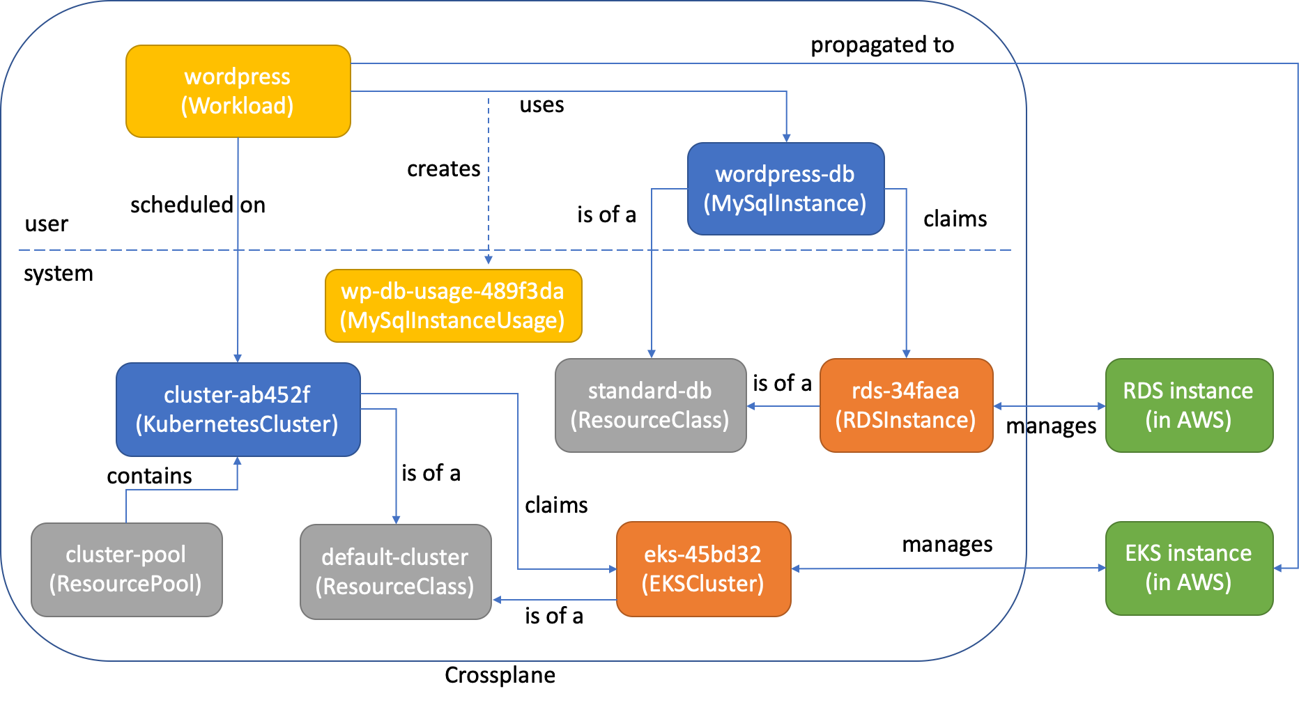
Peeking behind the scenes – Word press as an example
As soon as the wordpress-db instance was created, a resource controller noticed it and along with the default standard-db resource class configured by the administrator provisioned an instance of an RDSInstance object rds-34faea.
The RDS resource controller is responsible for creating the corresponding external resource in AWS and managing it from this point.
Similarly, when the wordpress workload was created, the workload scheduler noticed it and scheduled it to run on the only available kubernetes cluster. The scheduler will propagate the workload payload along with connection information to the target cluster.
The usage object will reference a secret the holds that connection information for the RDS instance and will ultimately be propagated to the target cluster along with the workload. The resource usage also enables us to modify security groups in AWS to enable the wordpress container to connect to the RDS instance.
Crossplane is based on the resource management model of Kubernetes. It use a declarative management approach in which we model workloads and their resources as portable abstractions that capture the user’s desired state, and rely on asynchronous controllers to continuously reconcile desired and observed state. All interactions between clients and controllers go through the same API server, which exposes CRUD operations on persistent objects that are stored in an etcd store.

Slide 39
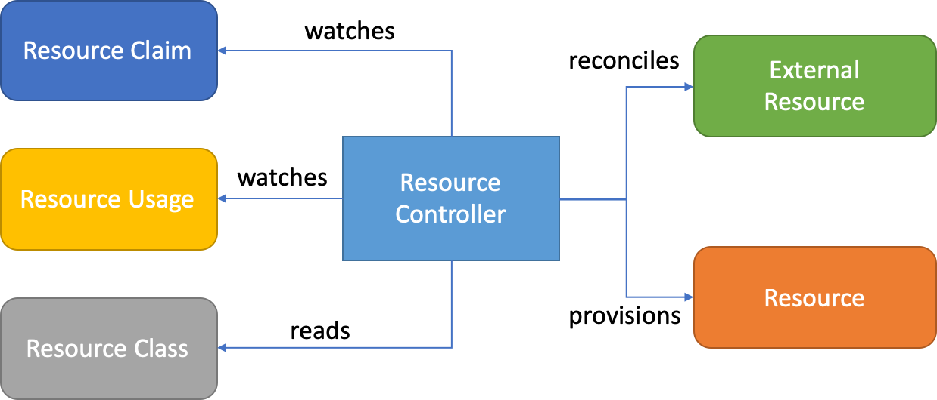
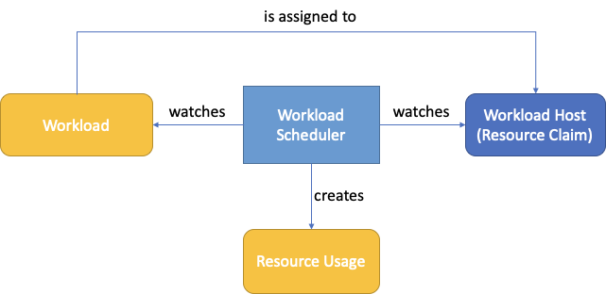
A resource controller watches the resource claim and can dynamically provision a resource based on the configuration in the claim and corresponding class.
The workload scheduler can include numerous criteria during scheduling that includes workload affinity/anti-affinity, taints/tolerations, selectors, capacity, quotas, policy, topology and cost. Many of these techniques are based on lessons learned from pod scheduling in Kubernetes. The scheduler is extensible and multiple schedulers can run within the same crossplane.
The workload scheduler also understands resource usage, and is also able to schedule the resources consumed by workloads. This is accomplished by delayed binding of resource claims to resources. You can set the bindingMode to WaitForFirstConsumer on a resource class to enable delayed binding.
The workload scheduler generates resource usage as it schedules workloads, and waits for them to be provisioned. This ensures that workloads do not start until the resources and their connection details have been provisioned.

Slide 40
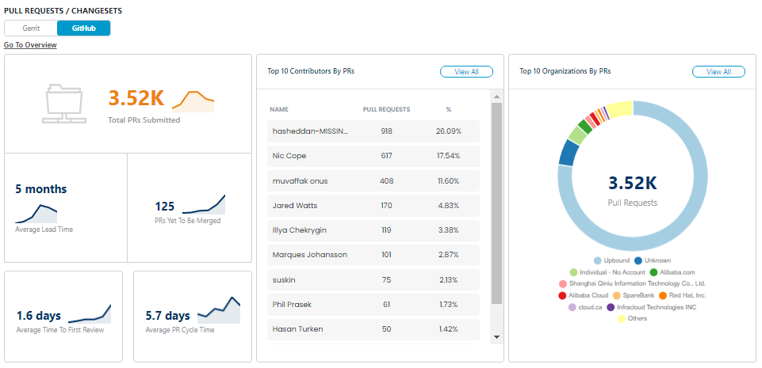
Community Insights
https://www.cncf.io/projects/crossplane/
https://github.com/crossplane/crossplane

